Slide 1
AUTONOMOUS VEHICLE
Semi & Self Driving

Slide 2
Definition
self-driving car is "a computer-controlled car that drives itself.“
self-driving car is also known as an autonomous vehicle (AV), driverless car, or robotic car (robo-car)
AV’s combine a variety of sensors like radar, lidar, sonar, GPS, odometry and inertial measurement units to perceive their surroundings.
These self-driving can also applicable for Trucks, Trains and Buses, etc.

Slide 3
Categorization
There are 6 levels of categories according to SAE International(Society of Automotive Engineers)
Level 0 - no automation
Level 1 - hands on/shared control
Level 2 - hands off
Level 3 - eyes off
Level 4 - mind off
Level 5 - steering wheel optional.

Slide 4
Semi Autonomous (Level 0 to 2)
Generally, Level 0 to 2 are often called Semi autonomous.
System which can accelerate, decelerate and stop without human action is called Semi autonomous.
Semi autonomous vehicles can be able to keep in lane, and some may also be able to park themselves, but they are not self-driving.
The first semi-automated car was developed in 1977, by Japan's Tsukuba Mechanical Engineering Laboratory, which required specially marked streets that were interpreted by two cameras on the vehicle and an analog computer.

Slide 5
Level 0 to 2
Level 0: The automated system issues warnings and may momentarily act but has no sustained vehicle control.
Level 1 ("hands on"): The driver and the automated system share control of the vehicle. Example: Cruise control, Parking Assistance, Lane Keeping Assistance Automatic emergency braking.
Level 2 ("hands off"): The automated system takes full control of the vehicle: accelerating, braking, and steering. The driver must monitor the driving and be prepared to action immediately at any time if the automated system fails to respond properly Example:Adaptive cruise control ,Super-Cruise.

Slide 6
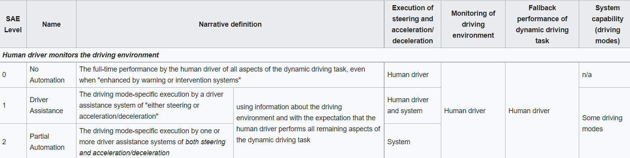
Level 0 to 2

Slide 7
Autonomous (Level 3 to 5)
Level 3 ("eyes off"): The driver can safely turn their attention away from the driving tasks. The driver must still be prepared to act within some limited time, specified by the manufacturer, when called upon by the vehicle to do so.
Level 4 ("mind off"): As level 3, but no driver attention is ever required for safety. However, self-driving is supported only in limited spatial areas or under special circumstances Example: slow down and park the car, if the driver does not retake control, robotic taxi or a robotic delivery service that covers selected locations in an area, at a specific time and quantities.
Level 5 ("steering wheel optional"): No human action is required at all. Example: robotic vehicle that works on all kinds of surfaces, all over the world, all year around, in all weather conditions.

Slide 8
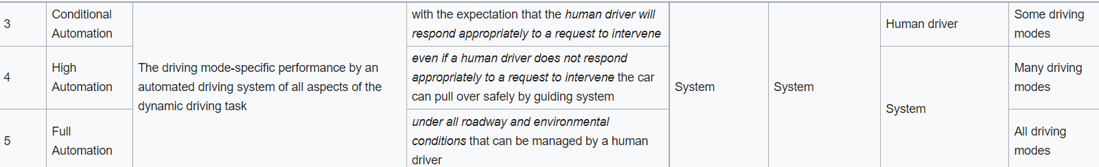
Level 3 to 5

Slide 9
AI in Self-Driving
Artificial Neural Network is made to learn and predict the outcomes of
Object Detection
Traffic lights & Signs Recognizer
Lane Tracker
Route Mapper
Dynamic Ranging
Prediction by NN
As Tesla is commonly used Self-driving car, we are going to look into it.

Slide 10
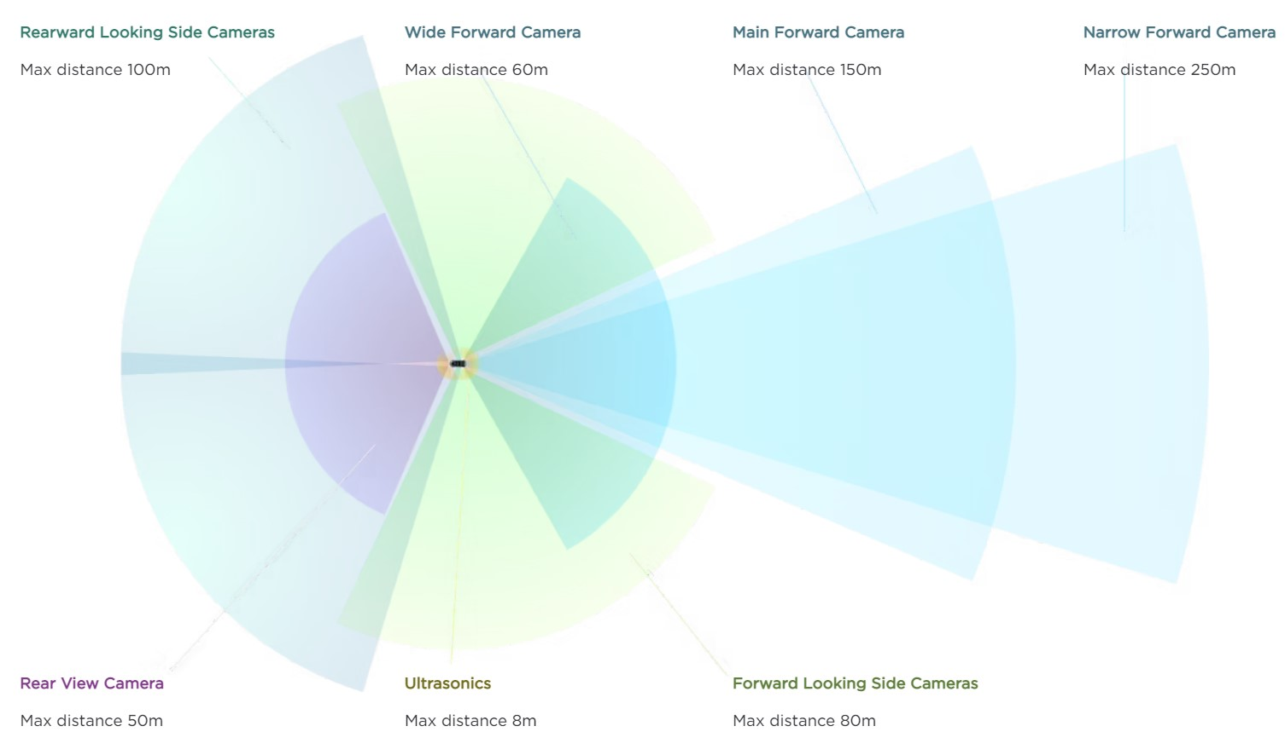
Tesla’s Autopilot
Tesla's Autopilot system currently uses 8 cameras, 12 ultrasonic sensors, and forward radar to read lane lines and detect nearby cars.

Slide 11
Tesla’s AI
Ai follows these steps:
Data Compression – for ease of processing
Rectification Model – calibrates & process the data
Regnet (optimised CNN) – looking overall image while focusing specific objects
BiFPN – extracts everything & merges to send into next step
Transformer –fuses data into 3d representation called “vector space”
Feature Queue – takes few frames and save in cache
Kinematics Module – to calculate equations, distance, orientation, etc.
Video Module (RNN) – uses past & present inputs to predict
Trunk – all the decisions are sent back to driving system

Slide 12
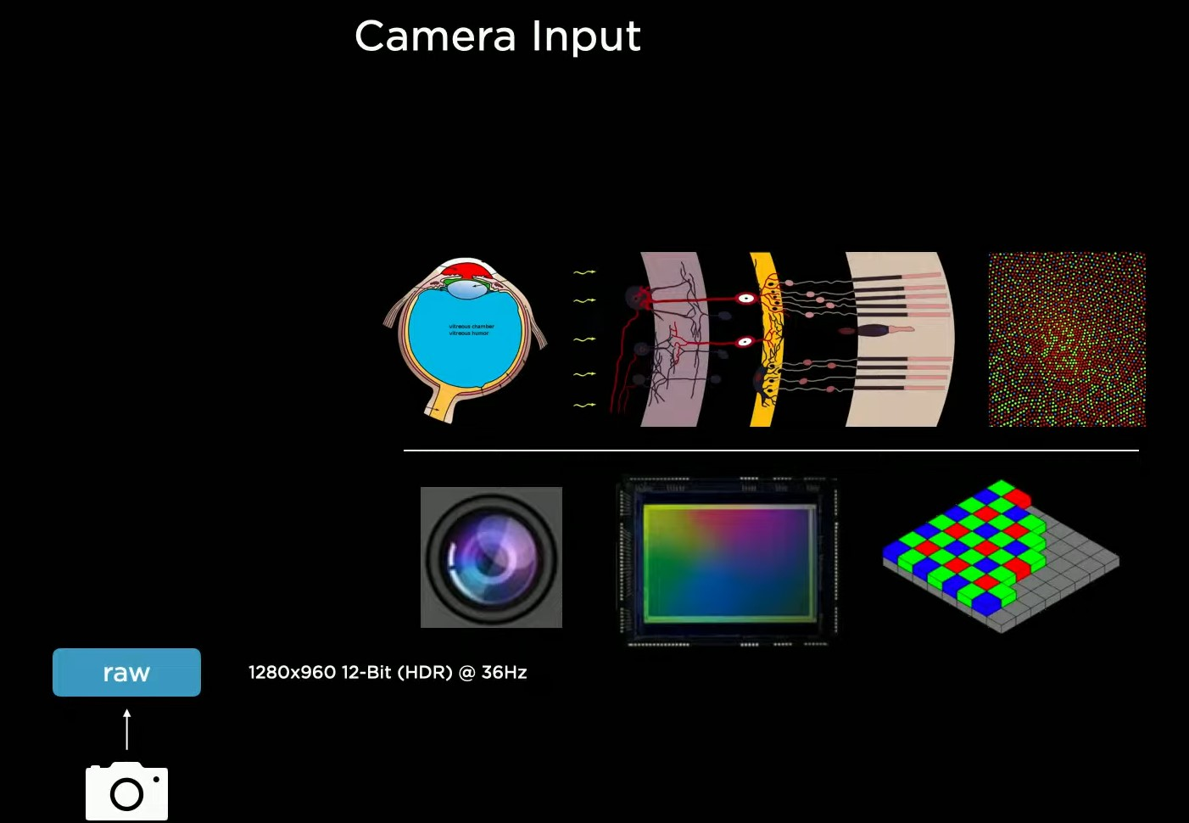
Input & Compression

Slide 13
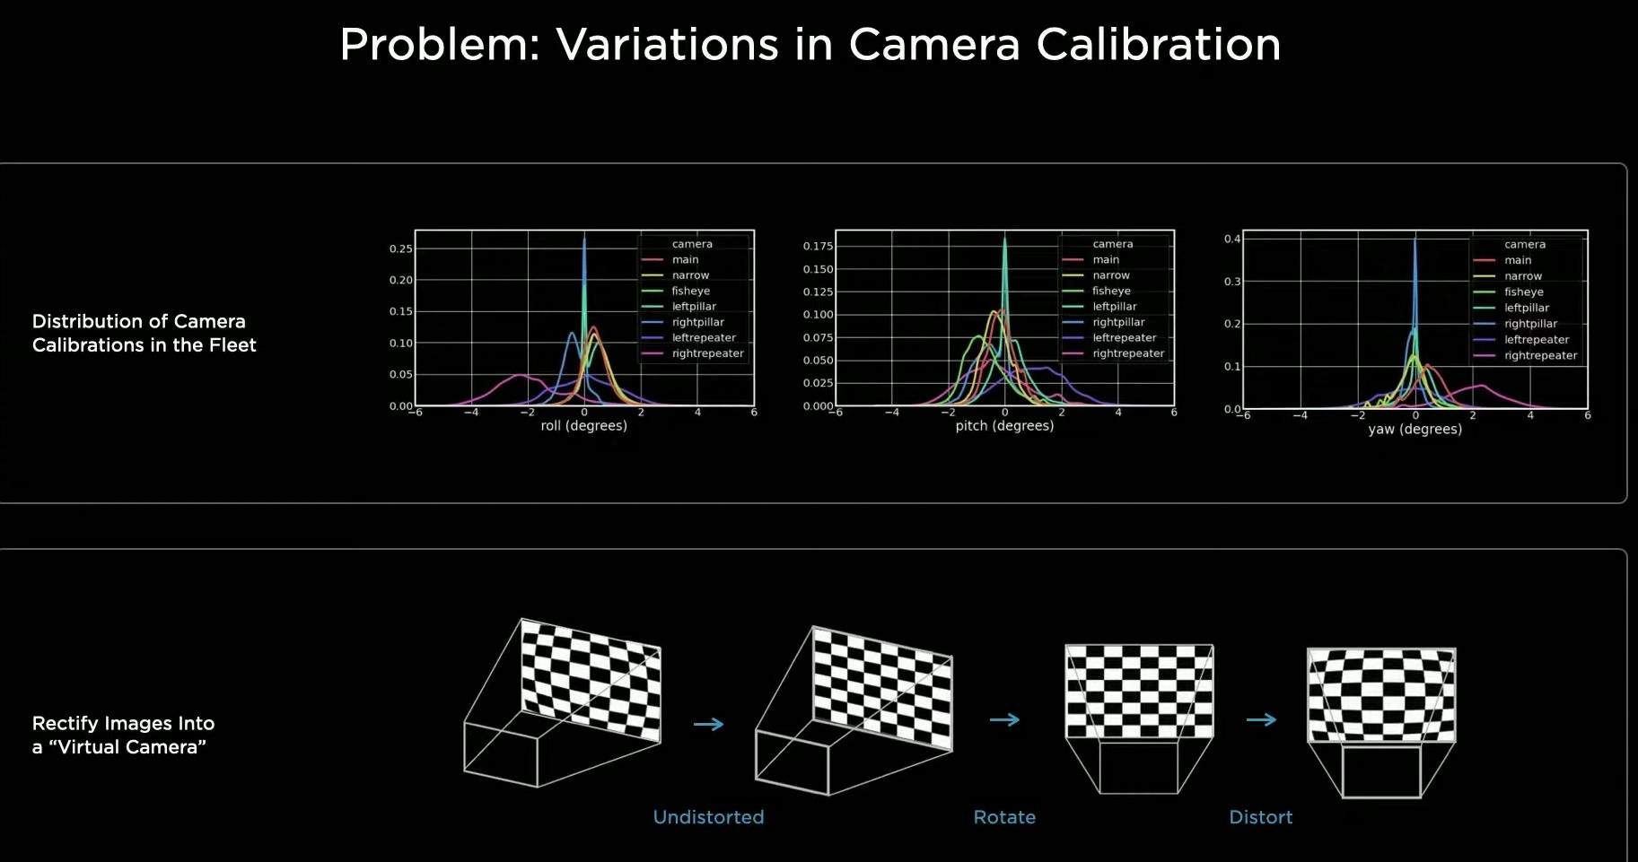
Rectification

Slide 14
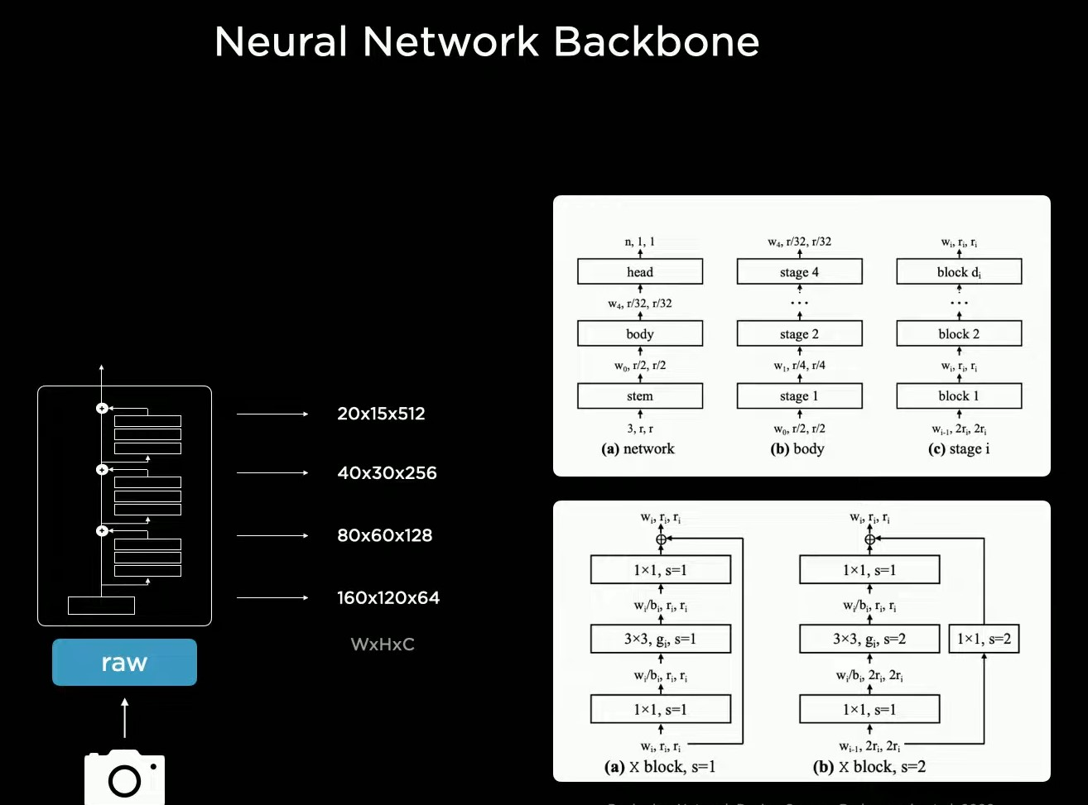
Regnet (Residual NN for extraction & CNN for label the data)

Slide 15
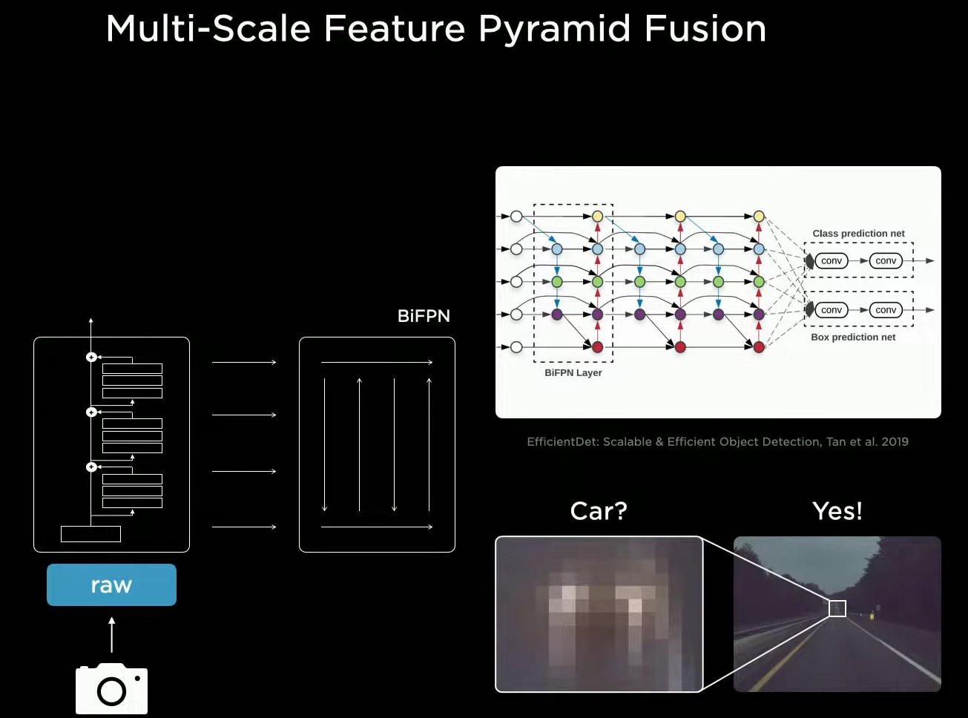
BiFPN(Weighted Bi-directional Feature Pyramid Network)

Slide 16
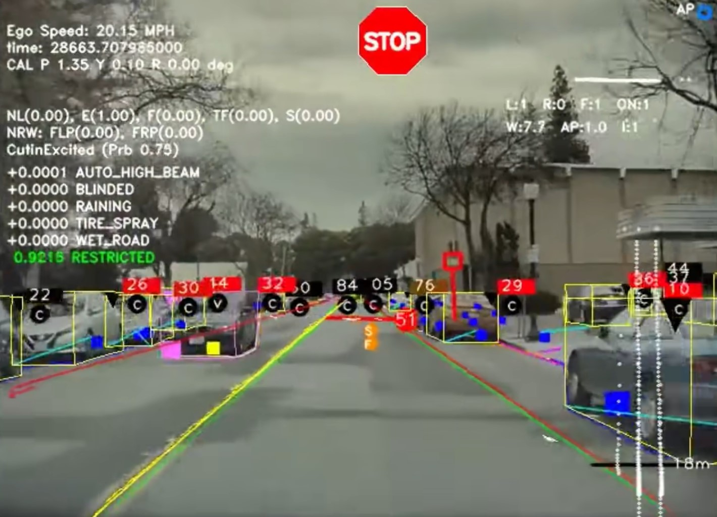
Output from BiFPN

Slide 17
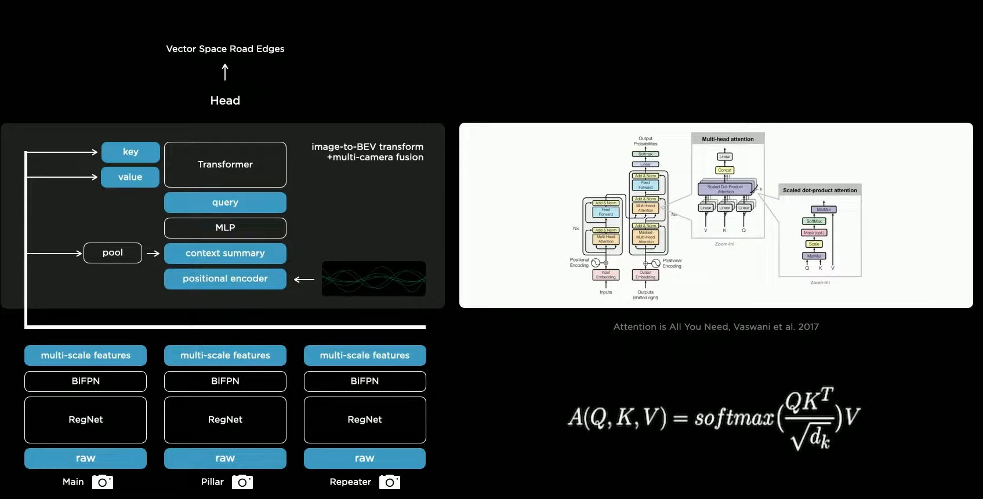
Transformer (information into 3D Vector Space)

Slide 18
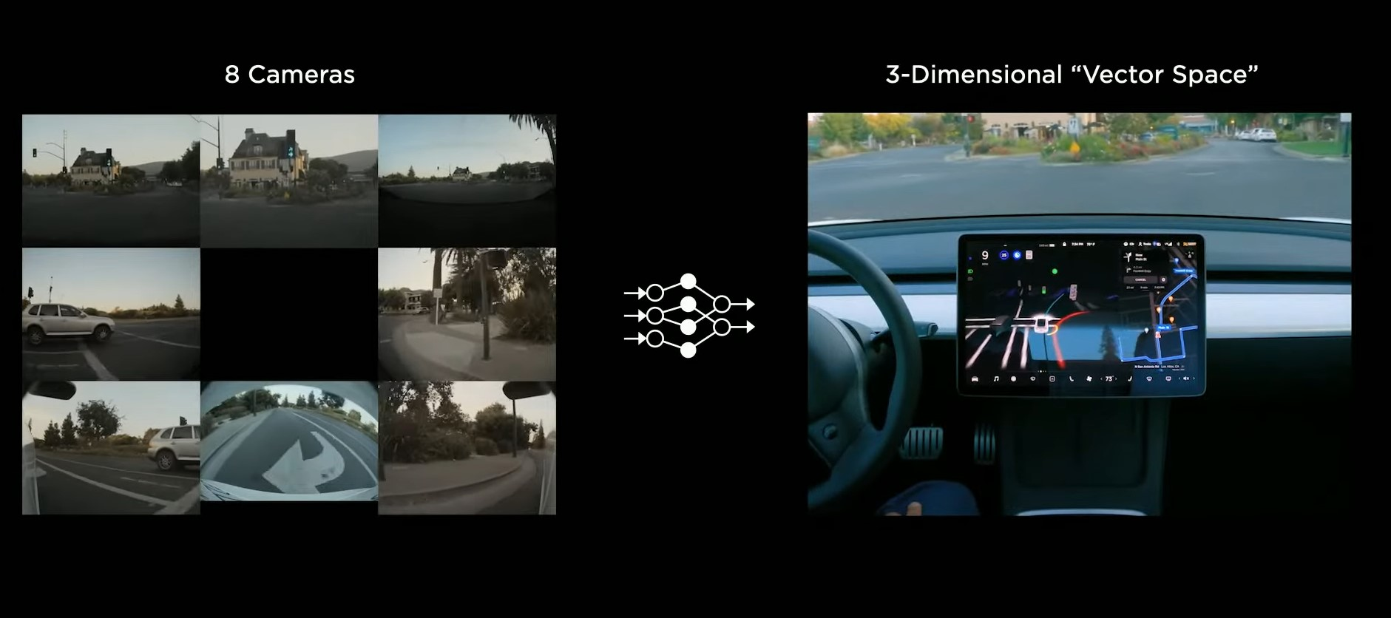
Output from Transformer

Slide 19
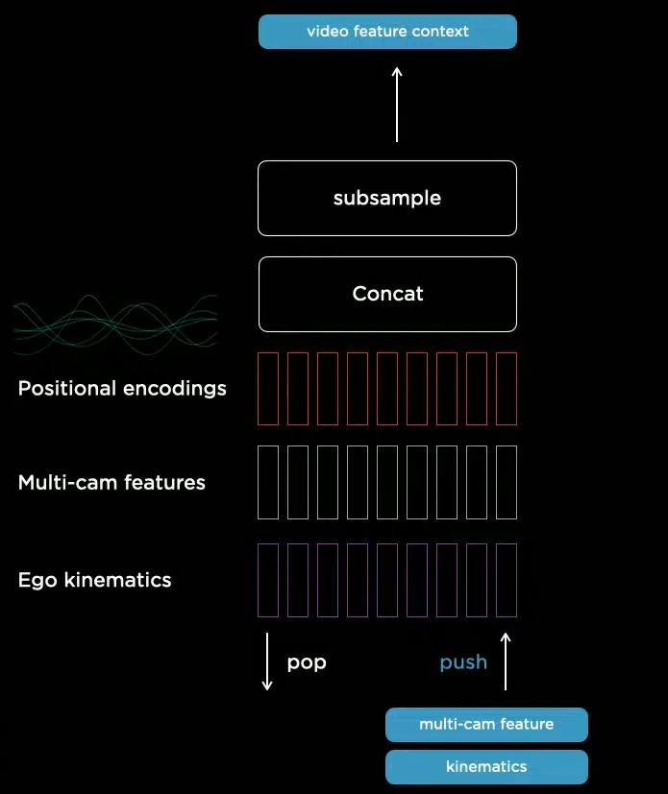
Feature Queue

Slide 20
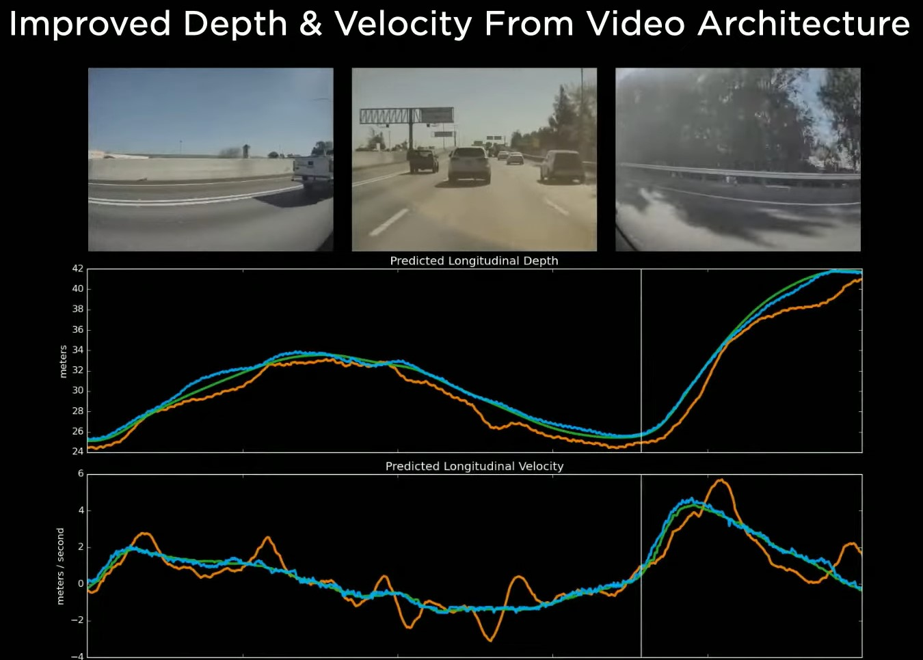
Kinematics (improving accuracy of NN over Radar)

Slide 21
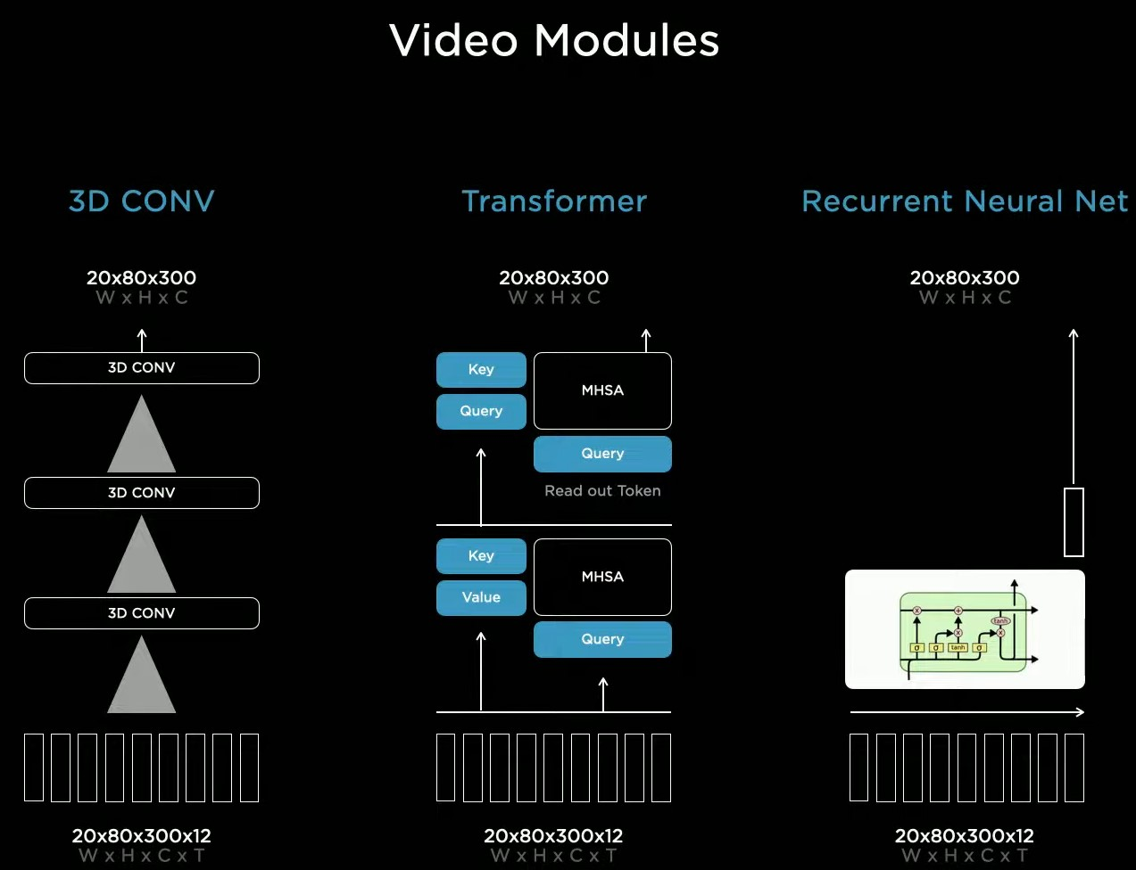
Video Module

Slide 22
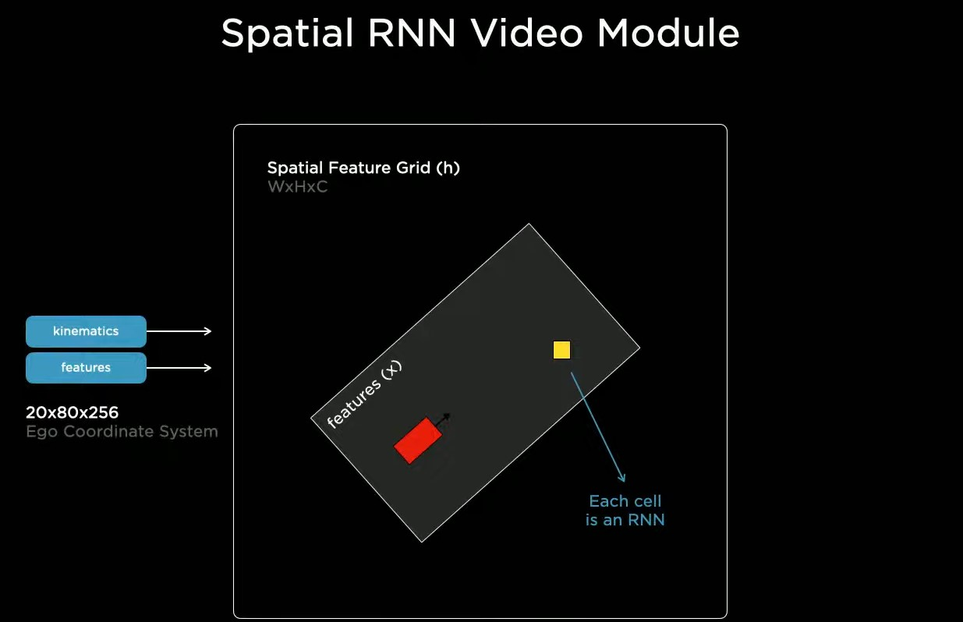
Video Module

Slide 23
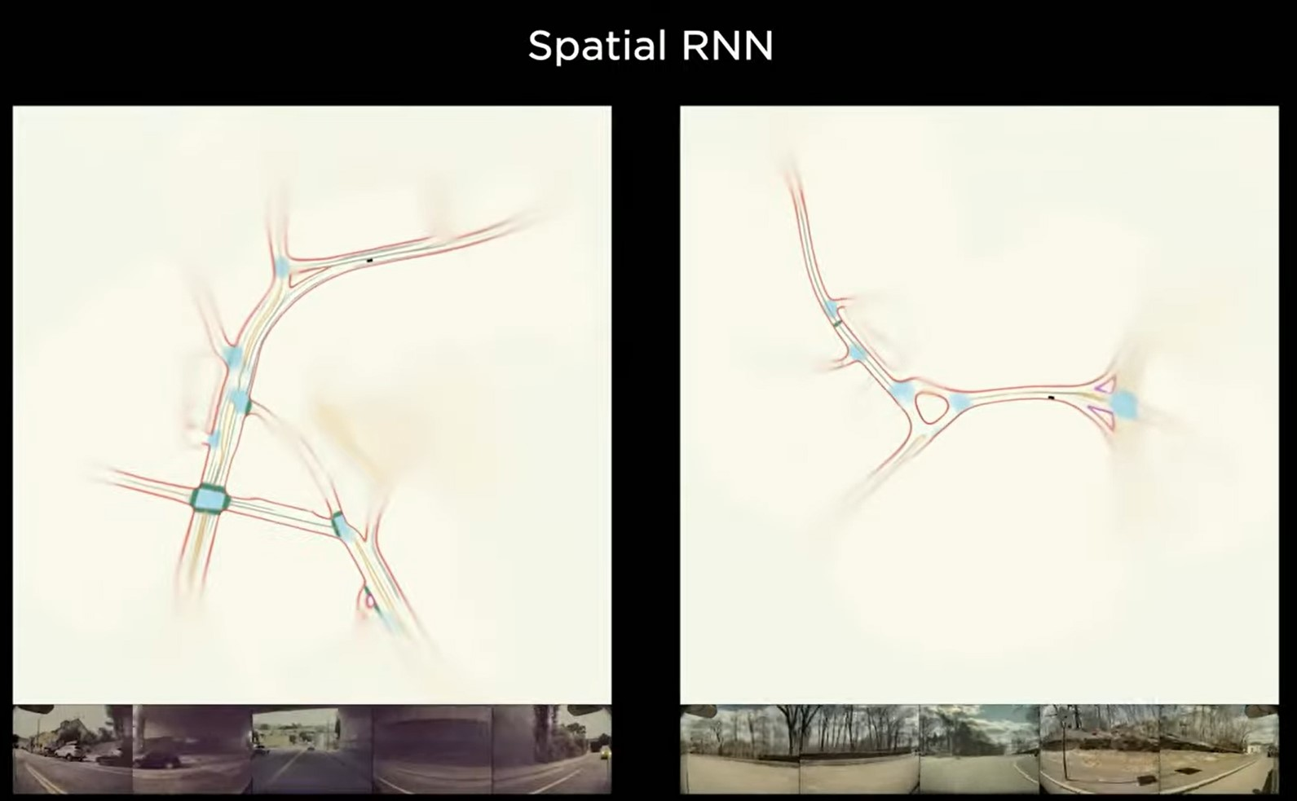
Output from Video RNN

Slide 24
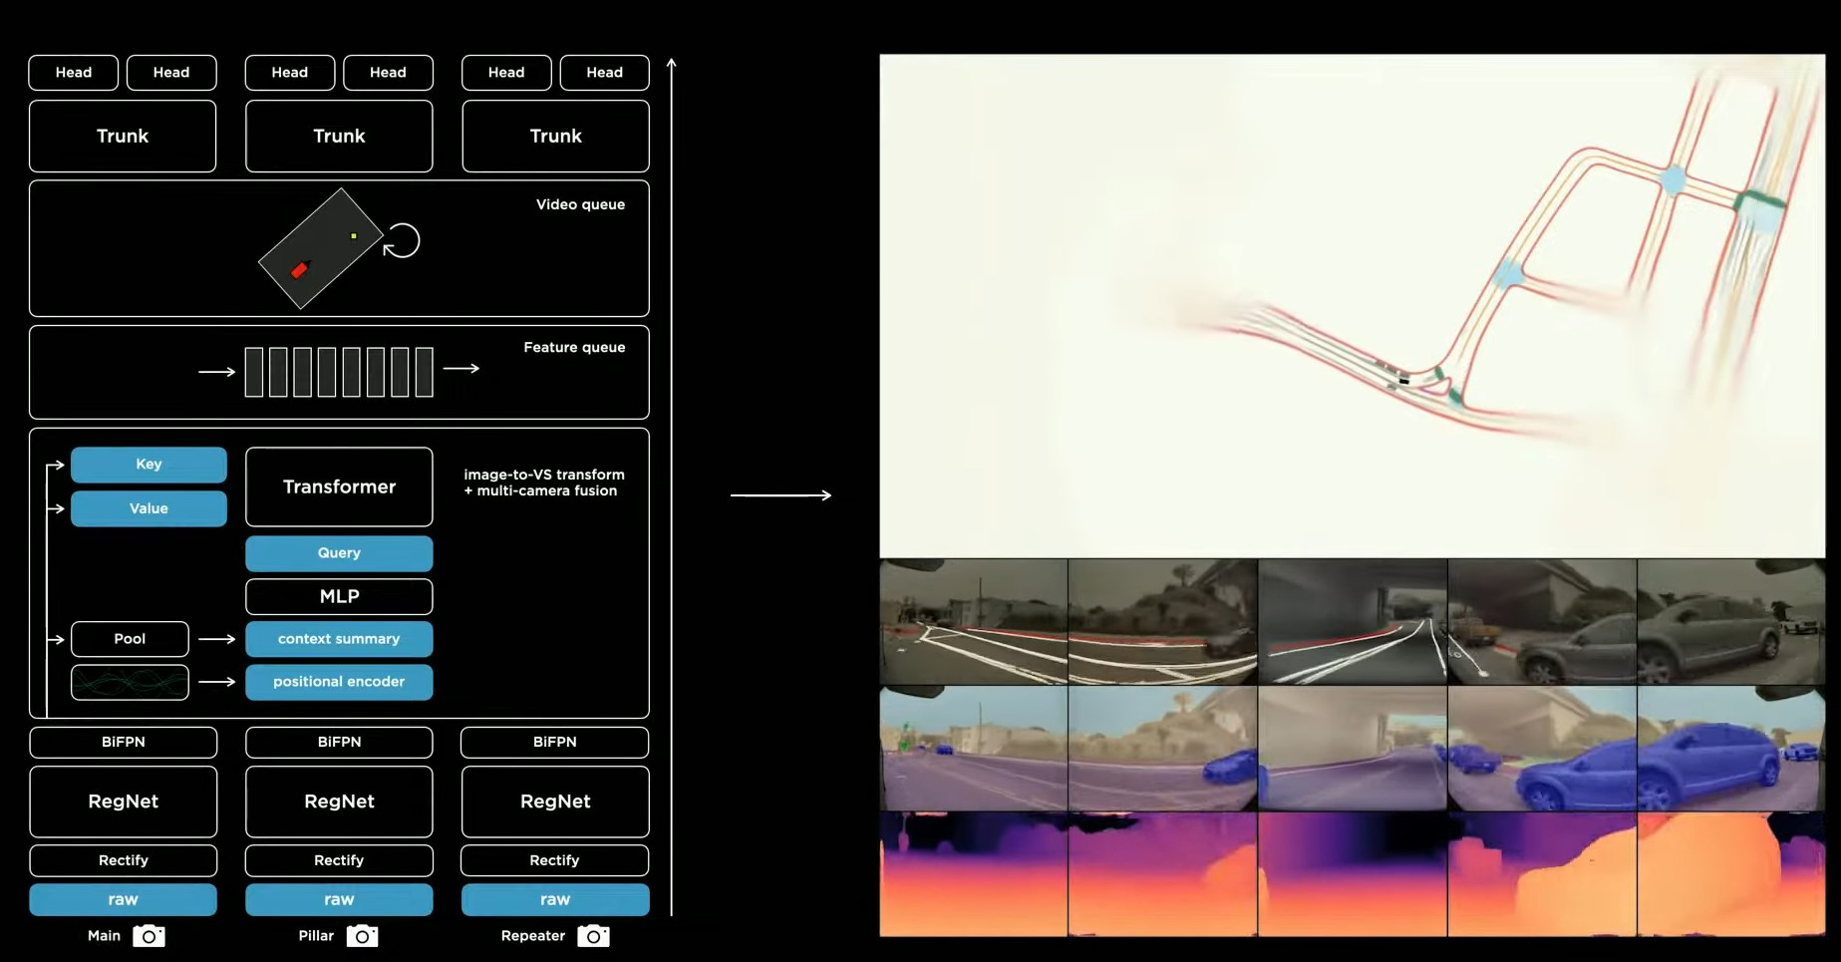
Final Output (comparison b/n stages)

Slide 25
AV’s Cars
Tesla Autopilot
Google Waymo
Uber ATG
Honda Legend Hybrid EX
Toyota e-Palette
AV’s in Testing:
BMW, Mercedes Benz, Apple, Nvidia, Sony, Nuro, Ford, Nissan, Aptiv,
Bosch, etc.

Slide 26
Autonomous Trucks & Vans
Otto and Starsky Robotics Truck
Tesla Semi
Tesla CyberTruck
Volvo Vera
Even Autonomous Trains
DB (deutsche bahn), in collaboration with siemens mobility, reveals the world's first self-driving train in the city of Hamburg.
Japan’s Fastest Autonomous Trains are in testing.

Slide 27
Advantages of AV’s
Reduced Accidents
Reduced Traffic Congestion
Reduced CO2 Emissions
Increased Lane Capacity
Lower Fuel Consumption
Last Mile Services
Transportation Accessibility
Reduced Time & Transport Costs
More Effective & Affordable Taxis
More Efficient Parking

Slide 28
Problems (to be rectified)
Expensive
Safety and security concerns
Prone to Hacking
Fewer job opportunities for others
Non-functional sensors
Software Bugs & Errors

Slide 29
Thank You!
-By Team Galaxy

